Slide 1
Big Data Fundamentals
Week#3
Dr. Ahmed Awais

Slide 2
Outline
The V’s,
DIKW,
Challenges
KPIs & Analytics – Maybe next lecture

Slide 3
The V’s
Volume
Velocity
Value – Skip it, will consider it at last – but why 🤔?
Variety
Veracity
…..

Slide 4
The V’s
Volume
Velocity
Value – Skip it, will consider it at last – but why 🤔?
Variety
Veracity
Variability - Data meaning changes over time or context.
Apple is a fruit or company
Validity (Correctness for Intended Use) - Data is correct and suitable for analysis.
Vulnerability (Security threats) - Exposure to cyber threats.
Patient data breaches in healthcare systems
Volatility (data lifespan) - How long data remains useful.
Visualization - Presenting data in charts/graphs.

Slide 5
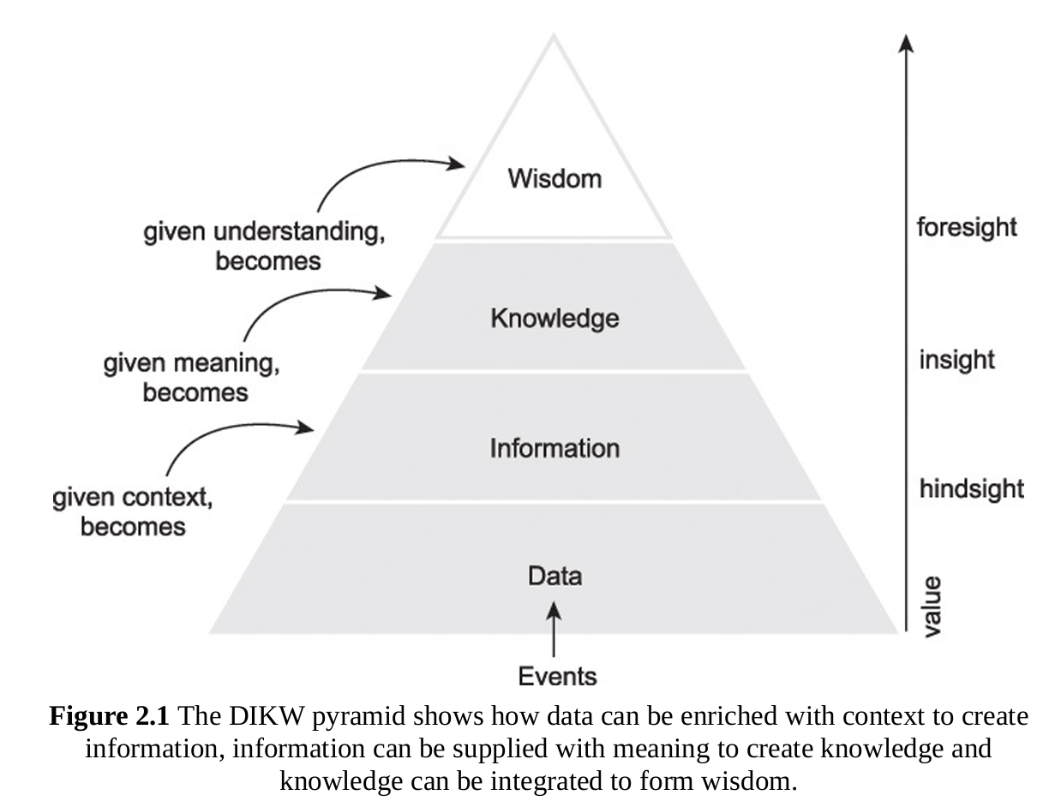
The DIKW Pyramid

Slide 6
D
Data (Raw Facts)->such as raw data collected from stores:
Product A sold 120 units Monday
Product A sold 60 units Tuesday
Product A sold 200 units Friday
Customer purchases recorded in POS system
Website clickstream logs
These are raw numbers without meaning.

Slide 7
I
Information (Context Added)
After processing the data:
Sales are higher on weekends
Product A sells more during promotions
Online traffic increases after social media ads
Now the data becomes information with context.

Slide 8
K
Knowledge (Patterns and Understanding)
Data analysts discover patterns:
Weekend promotions increase sales by 40%
Customers aged 18–30 respond strongly to social media ads
Stock shortages reduce potential revenue
This creates knowledge about customer behavior and sales patterns.

Slide 9
W
Wisdom (Strategic Decision)
Management decides:
Run targeted promotions on weekends
Increase inventory before weekend demand
Focus marketing campaigns on younger customers
This is wisdom: applying knowledge to make decisions.

Slide 10
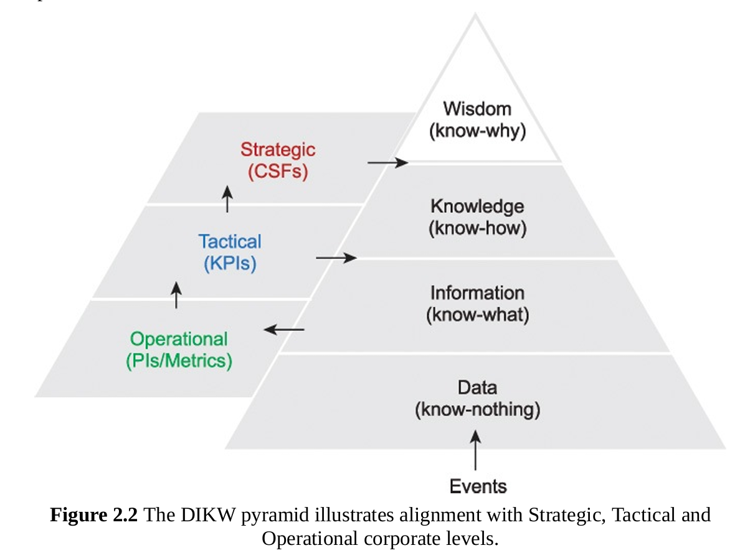
The DIKW Pyramid

Slide 11
The DIKW Pyramid
DIKW Level | Corporate Level | Example
Data | Operational Level | Cash registers record sales transactions
Information | Tactical Level | Sales reports show weekend demand
Knowledge | Tactical / Managerial | Analysts identify promotion effectiveness
Wisdom | Strategic Level | Executives design long-term marketing strategy

Slide 12
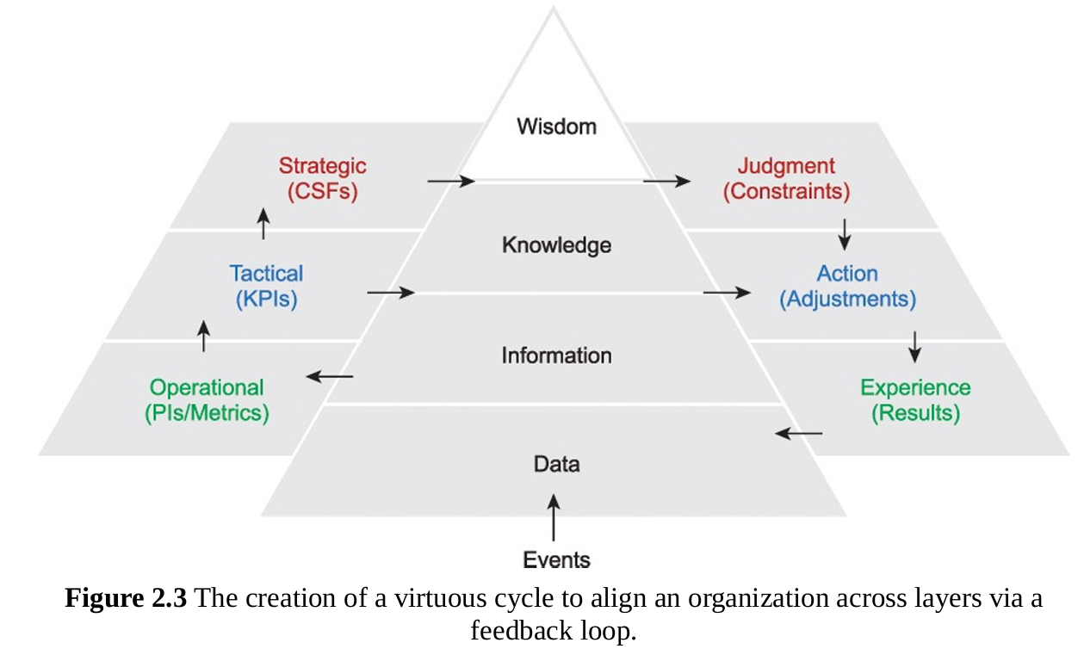
The DIKW Pyramid

Slide 13
The DIKW Pyramid- Virtuous Cycle with Feedback Loop
Company launches weekend promotions
New sales data is generated
Data is analyzed again
Strategies are refined

Slide 14
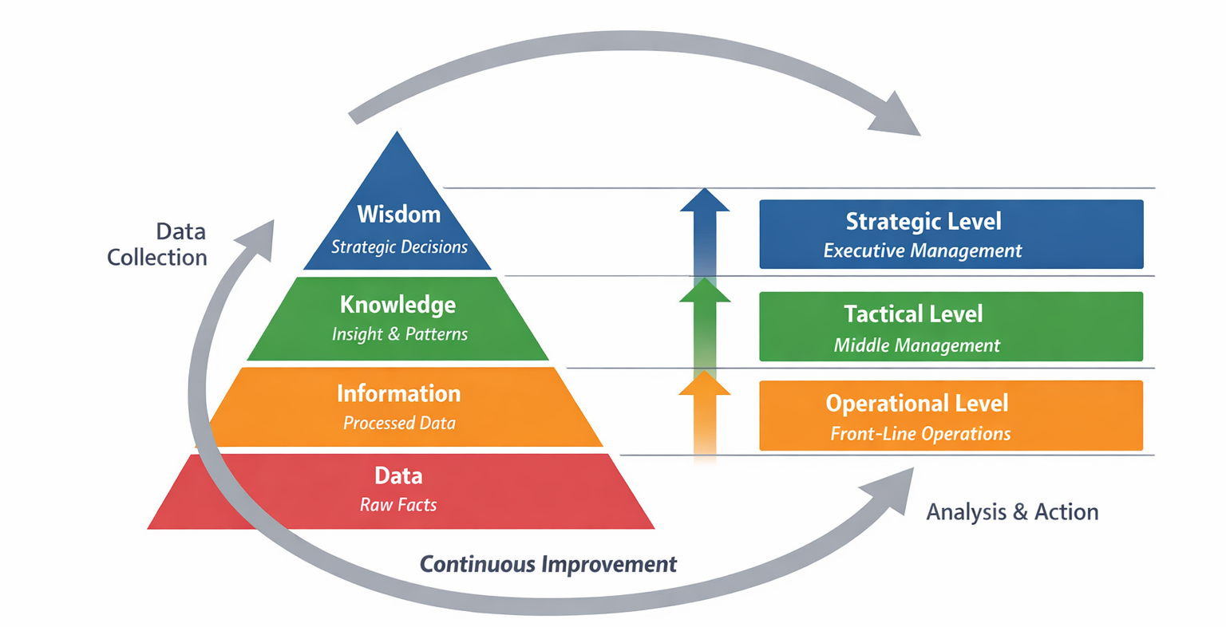
Putting Earlier three pyramids together

Slide 15
Putting Earlier three pyramids together
A retail company collects sales transaction data (data). D When the data is analyzed, it shows higher weekend sales (information). I Further analysis reveals that promotions significantly increase weekend purchases (knowledge). K Management then decides to launch targeted weekend promotions and increase inventory (wisdom). W
Operational systems collect data, managers analyze reports at the tactical level, and executives make strategic decisions. The results generate new data, creating a feedback loop that continuously improves business strategy.

Slide 16
Big Data Challenges & HDFS - Slide#18 of week#3 and onwards

Slide 17
Week#4 24 March 2026

Slide 18
Outline
Quick Recall of DIKW Pyramid (from last lecture)
Understanding the Insights
Extracting Insights (valuable vs Trivial)
KPI
Types of Analytics

Slide 19
Healthcare – Patient Readmission
Data (D) – Hospital collects electronic health records: patient demographics, diagnoses, treatments, length of stay, and discharge dates.
Information (I) – Analysis shows that patients with heart failure are readmitted within 30 days at a rate of 22%, significantly higher than the hospital average of 8%.
Knowledge (K) – Further analysis reveals that the majority of readmissions occur among patients who had no follow‑up appointment scheduled before discharge.
Wisdom (W) – Hospital administration mandates that every heart‑failure patient must have a follow‑up appointment scheduled and confirmed prior to discharge, and a care coordinator calls within 48 hours.
Feedback loop – The intervention reduces 30‑day readmissions to 12%; new readmission data is continuously monitored, enabling further refinement of discharge protocols.

Slide 20
Finance – Credit Card Fraud
Fraud detection rules are updated: transactions matching that profile are automatically blocked unless verified by a one‑time passcode sent to the customer’s registered phone.
Alerts flag that transactions from a certain geographic region have a fraud rate five times higher than the overall average.
Further, Machine learning models reveal that fraud patterns cluster around small‑dollar purchases made late at night in that region, often followed by larger withdrawal attempts.
Transaction logs include timestamp, amount, merchant category, location, and customer device information.
Feedback loop – Fraud losses in that region drop by 80%; flagged transactions are reviewed weekly to refine the detection algorithm.
Notes:
W,I,KD -?

Slide 21
Agriculture – Crop Yield Optimization
Sensors and satellite imagery collect soil moisture, nutrient levels, weather data, and historical yield per field.
A dashboard shows that the southeast field produces 20% less corn than the farm average, despite similar inputs.
Correlation analysis reveals that the low‑yield area has poor drainage, leading to waterlogging after heavy rain; yields drop sharply following any rainfall > 2 inches in a week.
Farmers install subsurface drainage tiles, adjust irrigation schedules, and switch to a more flood‑tolerant corn variety for that specific field.
Feedback loop – The following season, the field’s yield matches the farm average; continuous sensor data helps fine‑tune drainage and irrigation settings for future planting cycles.
Notes:
W,I,KD -?

Slide 22
What is an Insights
An insight is a deep, non‑obvious understanding derived from data that can inform decisions or create value.
It goes beyond simple reporting – it uncovers patterns, anomalies, or causal relationships that were previously hidden.
Characteristics of a Valuable Insight:
Actionable – leads to a clear next step
Novel – not already known or obvious
Quantifiable – can be measured and validated
Timely – relevant for current decisions

Slide 23
What is an Insights
Customers who buy diapers are 3× more likely to buy formoula milk.” This insight is actionable (paired‑promotion), novel (not common sense), quantifiable (lift factor)
Customers who buy diapers are 3× more likely to buy beer on Thursday evenings.” This insight is actionable (cross‑promotion), novel (not common sense), quantifiable (lift factor), and timely (weekly pattern)

Slide 24
Valuable vs. Trivial Insights
Trivial: “Sales increase on weekends” – expected, no deep value.
Valuable: “Weekend sales surge only when both a discount code is used and the product category is electronics” – specific, unexpected, leads to targeted marketing.

Slide 25
The Insight Extraction Process
Identify relevant data – internal & external sources
Clean & prepare – handle missing values, standardize formats
Explore visually & statistically – correlations, distributions, aggregations
Apply analytical techniques – machine learning, clustering, regression
Interpret & validate – domain experts must confirm findings

Slide 26
Key Performance Indicators
A KPI is a metric that gauges success within a particular business context. KPIs are linked with an enterprise’s overall strategic goals and objectives.
Characteristics:
Quantifiable
Aligned with strategy
Provides a reference point (target vs. actual)
Often displayed on dashboards / scorecards

Slide 27
SMART KPIs
Specific – clearly defined
Measurable – quantifiable
Attainable – realistic
Relevant – aligned to strategy
Timely – measured at appropriate intervals

Slide 28
SMART KPIs
Specific – clearly defined
Measurable – quantifiable
Attainable – realistic
Relevant – aligned to strategy
Timely – measured at appropriate intervals

Slide 29
SMART KPIs
Project scope and milestone completion
KPI: Complete 100% of project milestones on schedule (4 milestones) by the semester deadline.
Specific: Four defined milestones — literature review, data collection/cleaning, analysis/modeling, final report & presentation.
Measurable: Milestone status (Not started / In progress / Complete).
Achievable: Milestones sized for student team capacity.
Relevant: Keeps project on track and avoids last-minute rush.
Time-bound: Each milestone has a date (e.g., literature review by Week 3, data cleaning by Week 6, modeling by Week 9, final report by Week 12).

Slide 30
SMART KPIs
Data ingestion and cleaning quality
KPI: Achieve >= 95% successful ingestion and cleaning of the dataset (no critical missing values or schema errors) within 2 weeks of data acquisition.
Specific: Define "successful" as dataset loaded into the chosen storage (CSV/Parquet/HDFS) with key fields populated and documented.
Measurable: Percentage of records passing validation checks (schema present, required fields non-null, value ranges valid).
Achievable: Reasonable threshold for class project scale.
Relevant: Clean data is essential for valid analysis.
Time-bound: Complete within 2 weeks after acquiring raw data.

Slide 31
SMART KPIs
Code quality and reproducibility
Iterative Model performance
Documentation completeness
Presentation and reporting effectiveness

Slide 32
SMART KPIs
Learning outcomes (individual)
KPI: Each team member completes 3 targeted learning tasks (e.g., Hadoop basics, Spark ETL, SQL tuning, or data visualization best practices) and demonstrates competency through short peer-taught sessions by Week 11.
Specific: Assign tasks per member; require 15-minute demo or tutorial.
Measurable: Completion and peer feedback rating.
Achievable: Bite-sized learning goals.
Relevant: Ensures balanced skill growth across the team.
Time-bound: By Week 11.

Slide 33
SMART KPIs - Daily life Examples

Slide 34
SMART KPIs - Daily life Examples
Personal fitness Plan
Study routine
Household chores
Savings
Sleep Hygine
Learning new language
etc

Slide 35
KPIs Connect DIKW & Analytics
Data → raw numbers (e.g., sales revenue, number of transactions)
Information → contextualized metrics (e.g., revenue per customer)
KPIs → selected metrics that track strategic goals (e.g., customer lifetime value, churn rate)
Insights → explain why KPIs are moving (e.g., high churn due to poor service)

Slide 36
Types of Analytics
Type | Question | Importance/Value | Complexity
Descriptive | What happened? | Low | Low
Diagnostic | Why did it happen? | Medium | Medium
Predictive | What will happen? | High | High
Prescriptive | What should we do? | Highest | Highest

Slide 37
Types of Analytics
Descriptive Analytics
Focus: historical reporting
Techniques: aggregations, dashboards, data visualization
Example: Monthly sales report showing total revenue, top products, regional breakdown.
Diagnostic Analytics
Focus: root cause analysis
Techniques: drill‑down, correlation, data mining
Example: Sales dropped in Q3; drill‑down reveals a specific product category underperformed due to a supply shortage.
Predictive Analytics
Focus: forecasting future outcomes
Techniques: regression, classification, time series, machine learning
Example: Predict which customers are likely to churn in the next month based on usage patterns.
Prescriptive Analytics
Focus: recommending actions to achieve goals
Techniques: optimization, simulation, decision rules
Example: Given a budget of $10,000 and predicted churn probabilities, determine which customers to target with retention offers to maximize retained customers.

Slide 38
Analytics Progression in Organizations
Most Organizations start with descriptive (80% of efforts)
Evolve to diagnostic and predictive as data matures
Prescriptive requires advanced skills, but yields highest ROI

Slide 39
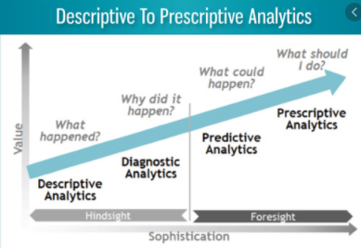
4 Types of Data Analytics
1) Descriptive analytics.
What is happened in the past or what is happening now (past)
2) Diagnostics Analytics
Why did it happen (present)
3) Predictive Analytics
What is likely to happen (future)
4) Prescriptive Analytics
What should we do (future)

Slide 40
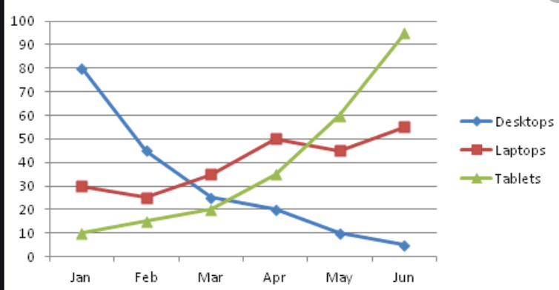
Descriptive analytics
Most basic and most used method.
It concentrates on reporting actual results
Change in profit margin from prior month
Mean, mode average of data
Monthly sales report
Concerned with understanding what is happening by examining past data.

Slide 41
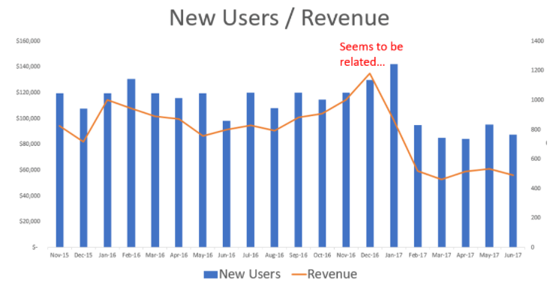
Diagnostics Analytics Why did it happen?
Detect correlations and pattern of interest
used to understand why something happened.
provides insight into the reason certain results occur
Why did the profit margin changed
Explain the reason for change in revenue

Slide 42
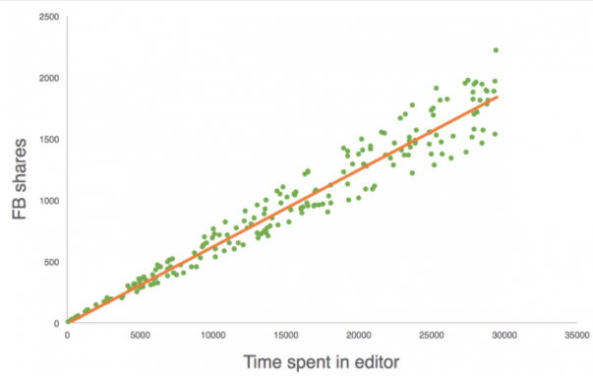
Predictive Analytics What is likely to happen?
Descriptive + Diagnostics
Predictive analytics (also called data mining) attempts to determine what is likely to occur.
Identifies common attributes or patterns that may be used to identify similar activity
Predict COGS
Predict Raw material need
Relies on advanced statistical methods, such as regression, cluster analysis, and pattern matching.
Involves applying assumptions to data and predicting future results

Slide 43
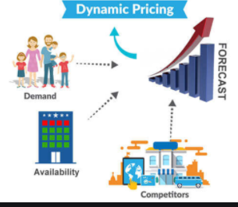
Prescriptive Analytics How should we act?
Based on diagnostics
Recommends actions on previously observed actions
concentrates on what an organization needs to do in order for the predicted future results to actually occur
Prescriptive analytics applies
advanced statistical methods
machine learning and
neural network analyses
Artificial Intelligence
For example, hotels set room prices using complex prescriptive models that consider hundreds of variables including days, weekend, holidays, competition, amenities, customer rating, taxes, activities in the area, number of site visitation, number of click to check prices etc.
Used by top executive or advanced analysts.

